Slide 1
Program Development and Programming Languages
ITSC 1401, Intro to Computers
Instructor: Samwel K.

Slide 2
Objectives
Explain the six steps in the program development life cycle
Describe top-down program design
Explain structured program design and the three basic control structures
Explain the differences among the categories of programming languages
Programming Languages, Chp. 12

Slide 3
Objectives
Describe the object-oriented approach to program development
Identify programming languages commonly used today
Identify the uses of application generators, macros, and RAD tools
Describe various Web page development tools, including HTML, DHTML, and XML
Programming Languages, Chp. 12

Slide 4
What Is a Computer Program?
A set of instructions that directs a computer to perform the tasks necessary to process data into information
Programming Languages, Chp. 12

Slide 5
The Program Development Life Cycle
Analyze or define the problem
Design programs
Code programs
Test programs
Formalize solution
Maintain programs
Programming Languages, Chp. 12

Slide 6
Program Development
The program development life cycle (PDLC) is an organized method of software development that bears many similarities to the system development life cycle (SDLC)
Programming Languages, Chp. 12

Slide 7
The Need for PDLC: Better Software, Please
Specifying the problem
Designing the program
Code-and-fix
Six phases of the PDLC
Coding the program
Testing & debugging the program
Formalizing the solution
Maintaining the program
Programming Languages, Chp. 12

Slide 8

A Few Definitions
Programming is also known as software development.
Programming is problem-solving
procedures which follows a
six-step process in
developing instructions
or programs.
Programming is the creation of lists of instructions for a computer.
Programming Languages, Chp. 12

Slide 9
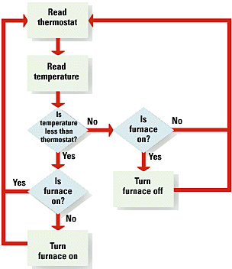
Computer Program - a collection of instructions, or statements (code) carried out by the computer’s CPU.
Programmers need
a model of the logical
process before they
can write the code.
Programming Languages, Chp. 12

Slide 10
Writing a Program
(More Clearly Defined)
Step 1: Program specification or defining the problem or Program Analysis.
Step 2: Develop an algorithm (or a step-by-step description of how to arrive at a solution).
Step 3: Code or write the program.
Step 4: Test the program and eliminate syntax and logic errors.
Programming Languages, Chp. 12

Slide 11
Writing a Program
(More Clearly Defined)
Step 5: Complete the documentation or description of the purpose and process of the program.
Step 6: Implement and maintain the system.
Programming Languages, Chp. 12

Slide 12
Who Should Write the Program?
System Engineers analyze the program, design the solution, organize large programs, and write clear documentation for all.
Although colleges and training institutes can provide training in these areas, it is often in a first job (after school completion) that programming skills are developed.
Programming Languages, Chp. 12

Slide 13
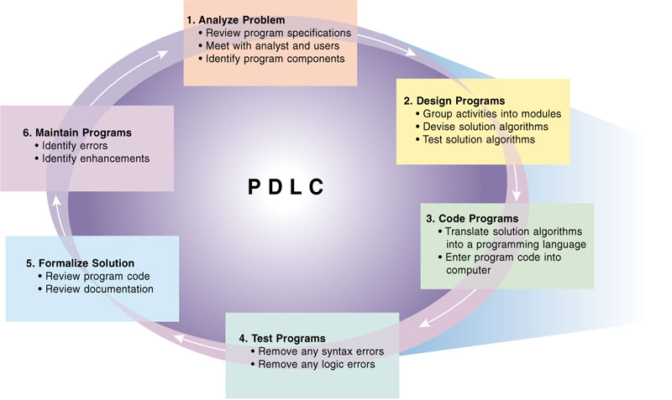
The Program Development Life Cycle (Continued)
Programming Languages, Chp. 12

Slide 14
What Initiates the Program Development Life Cycle?
End of the analysis phase of the system development life cycle
  Program specifications
  Program development life cycle (PDLC)
  Programming team
  Programmer Scarcity video
Programming Languages, Chp. 12

Slide 15
Six Steps in Developing a Program: Step #1
Define the Problem
  needed output
  available input
  definition of how to transform available input into needed output (or processing requirements).
Programming Languages, Chp. 12

Slide 16

What Is the Desired
Outcome?
Programming languages that do
“end-user work” are referred to as
application software.
Programming languages that control
computer operations are referred to as
system software.
Programming Languages, Chp. 12

Slide 17
Step 1 – Analyze Problem
Review the program specifications package
Meet with the systems analyst and users
Identify the program’s input, output, and processing requirements (IPO)
  IPO chart
Programming Languages, Chp. 12

Slide 18
What Initiates the Program Development Life Cycle?
End of the analysis phase of the system development life cycle
  Program specifications
  Program development life cycle (PDLC)
  Programming team
  Programmer Scarcity video
Programming Languages, Chp. 12

Slide 19
Step 1 – Analyze Problem
Review the program specifications package
Meet with the systems analyst and users
Identify the program’s input, output, and processing requirements (IPO)
  IPO chart
Programming Languages, Chp. 12

Slide 20
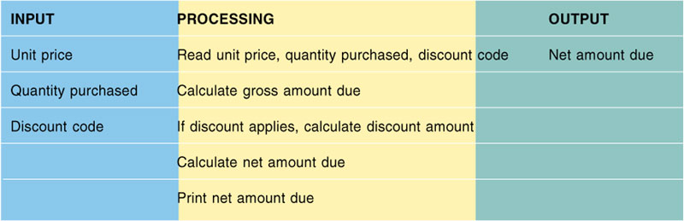
POS Chart –Assists in Analyzing a Program
Programming Languages, Chp. 12

Slide 21
Step 2 – Design Programs
Group the program activities into modules
Devise a solution algorithm for each module
Test the solution algorithms
Programming Languages, Chp. 12

Slide 22
Step 2 – Design Programs (Continued)
Top-down design
  Identify the major activity of the program
  Break down the original set of program specifications into smaller, more manageable sections which makes it easier to solve that the original one.
  Continue to break down subroutines into modules which is a section of a program dedicated to performing a single function.
  Hierarchy Chart or Top-Down Charts
Programming Languages, Chp. 12

Slide 23
What Initiates the Program Development Life Cycle?
End of the analysis phase of the system development life cycle
  Program specifications
  Program development life cycle (PDLC)
  Programming team
  Programmer Scarcity video
Programming Languages, Chp. 12

Slide 24

Six Steps in Developing a Program: Step #2
Algorithms
Design the Solution to the Solution
Programming Languages, Chp. 12

Slide 25
Developing an Algorithm
Programmers begin solving a problem by developing an algorithm. An algorithm is a step-by-step description of how to arrive at a solution. You can think of an algorithm as a recipe or a how-to sheet
WHILE there is still more pizza
Check to see if you’re still hungry
IF you are still hungry,
THEN Gobble down pizza
ELSE Put the rest in the fridge
Programming Languages, Chp. 12

Slide 26

Six Steps in Developing a Program: Step #2
Developing an algorithm is nothing more than developing a step-by-step description of how to arrive at a solution.
Would you try to bake a cake without a recipe? Would you try to ski without instructions on how to do it? Of
course not. The same is true in
developing a program.
Programming Languages, Chp. 12

Slide 27
Structured Programming Techniques
Hierarchy Charts
Top-Down Program Design or structure charts
Pseudocode (a fake code that can’t be understood by the computer).
Flowcharts
Logic Structures
Programming Languages, Chp. 12

Slide 28
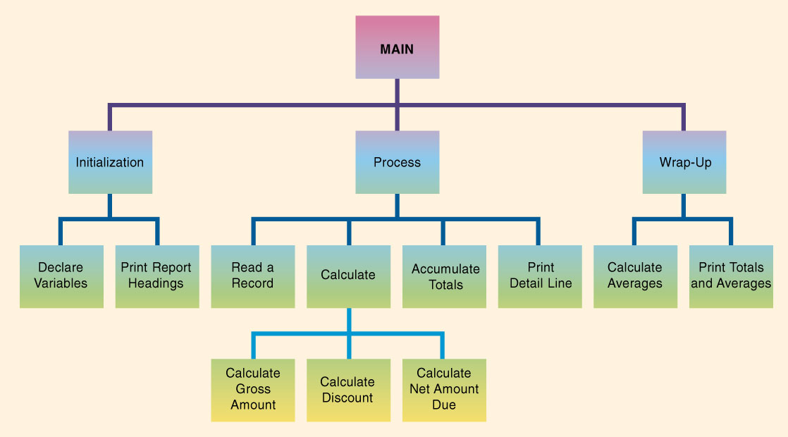
Hierarchy Chart
Programming Languages, Chp. 12

Slide 29
Program Design Tools
Hierarchy Charts
Shows Top-Down Design
Modules
  Control Modules
  Subordinate Modules
Programming Languages, Chp. 12

Slide 30
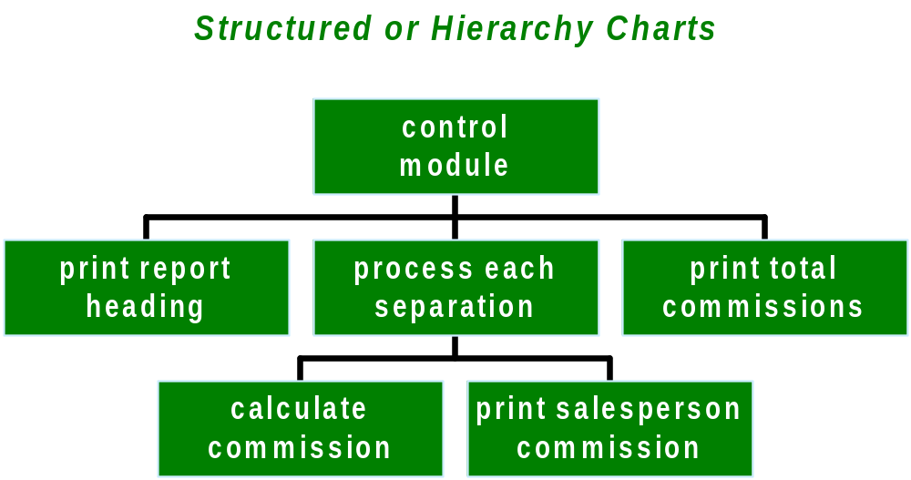
Program Design Tools
Each box, or module, in a structure chart indicates a task that the program must accomplish
Programming Languages, Chp. 12

Slide 31
Control Structure
Sequence control structure
    Go to the phone.
    Dial the pizza place.
    Order the pizza.
Hang up.
Selection control structure
    Open your wallet.
    IF you have enough money,
    THEN Go to the phone.
    Dial the pizza place.
    Order the pizza.
    Hang up.
Or ELSE Forget the whole thing.
Programming Languages, Chp. 12

Slide 32
Control Structures
Repetition control structure
Do-while
WHILE there is still more pizza, gobble down pizza
Do-until
DO gobble down pizza UNTIL none remains
Programming Languages, Chp. 12

Slide 33
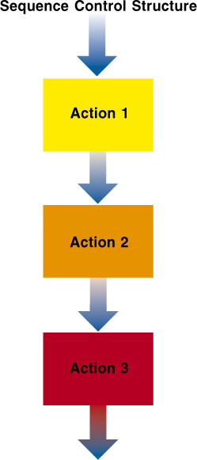
Structured Design
Sequence Control Structure
Programming Languages, Chp. 12

Slide 34
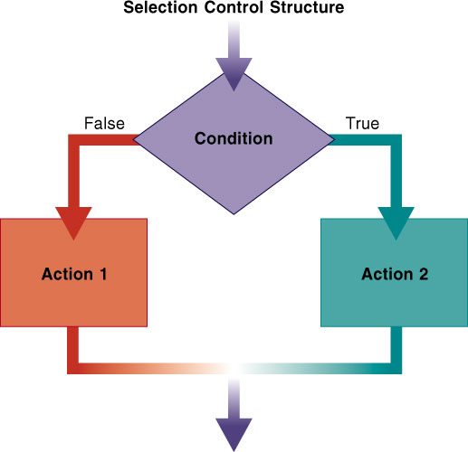
Structured Design (Selection Control Structure)
If-then-else control structure
Programming Languages, Chp. 12

Slide 35
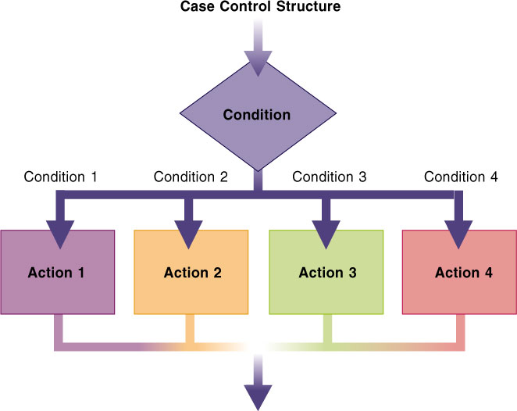
Case Control Structure
Programming Languages, Chp. 12

Slide 36
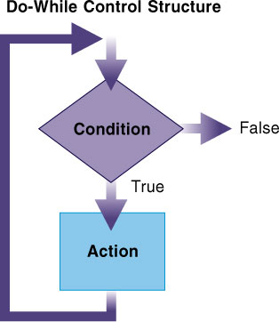
Do-While Control Structure
Programming Languages, Chp. 12

Slide 37
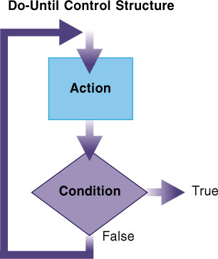
Do-Until Control Structure
Programming Languages, Chp. 12

Slide 38
Proper Program Design
Proper program design is constructed so that the program, and each of its modules has the following characteristics:
  No dead code
  No infinite loops
  One entry point
  One exit point
Programming Languages, Chp. 12

Slide 39
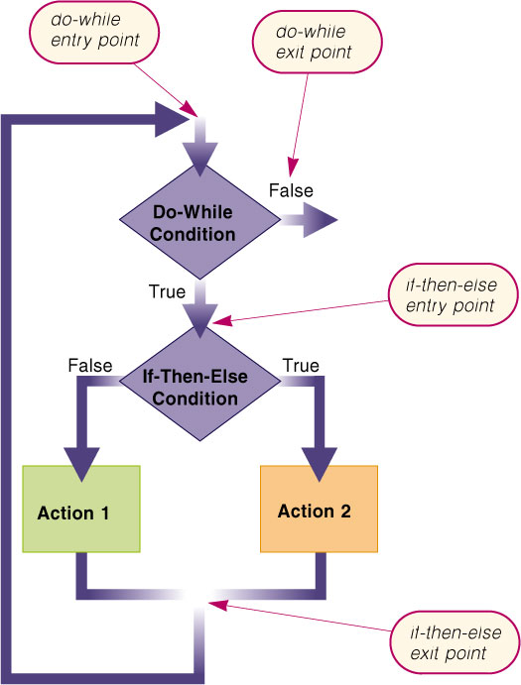
Programming Languages, Chp. 12

Slide 40
Program Design Tools
Commission program
get next salesperson
print headings
Flowchart
end of data
A
get first salesperson
A
print total commission
calculate commission
end
print salesperson
A flowchart is a diagram that shows the logic of a program. Each flowcharting symbol has a meaning
Programming Languages, Chp. 12

Slide 41
Program Design Tools
Start
Input
Data
Flowcharts
Diagram
Symbols
Process
Output
Infor.
Stop
Programming Languages, Chp. 12

Slide 42
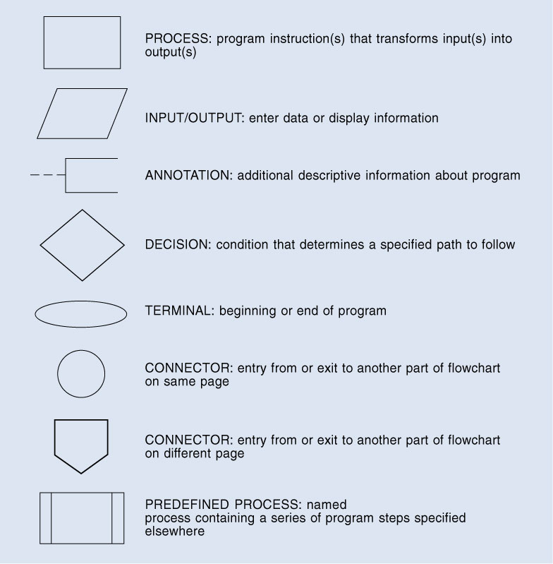
Design Tools
(Program Flowchart)
Process
Input/Output
Annotation
Decision
Terminal
Connector (on same page)
Connector (on different page)
Predefined Process
Programming Languages, Chp. 12

Slide 43
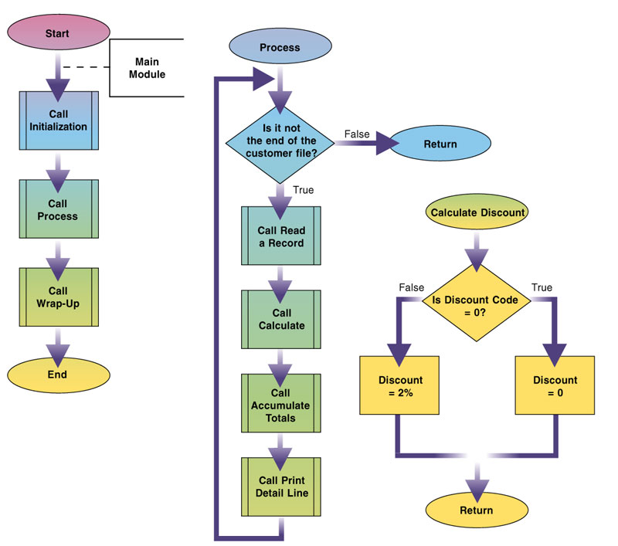
Programming Languages, Chp. 12

Slide 44
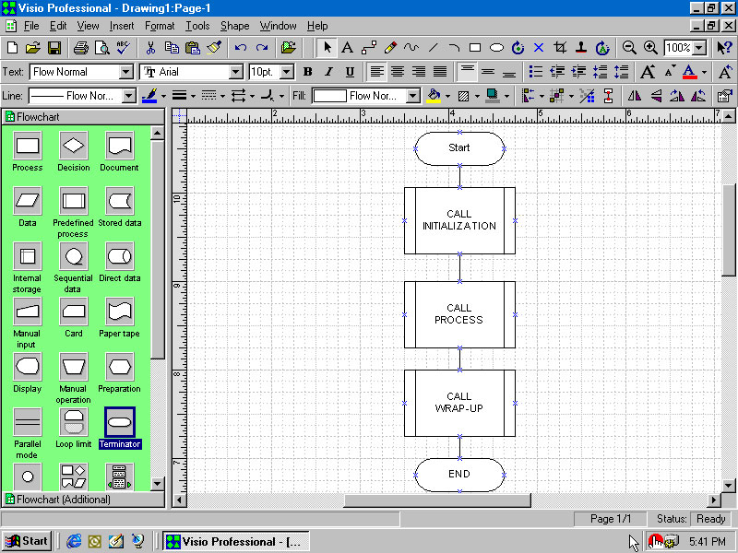
Visio Flowcharting Software Package
Programming Languages, Chp. 12

Slide 45
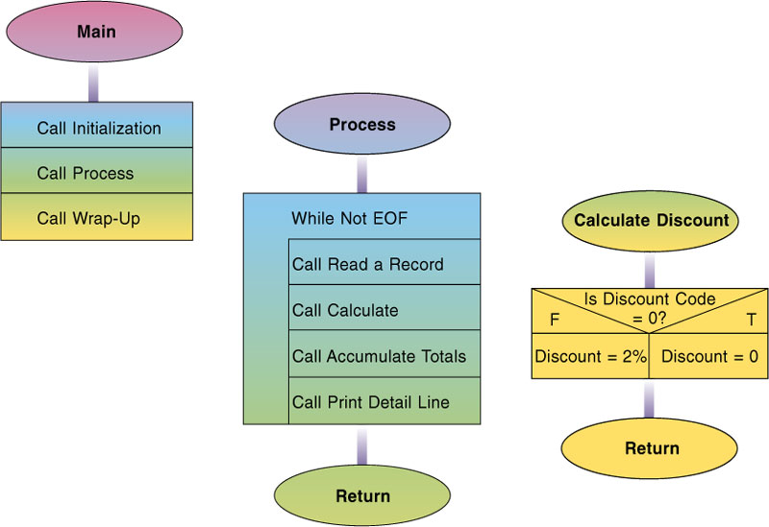
Nassi-Schneiderman (N-S) Chart
Programming Languages, Chp. 12

Slide 46

Program Design Tools
Pseudocode
Alternative to Flowcharts
Programming Languages, Chp. 12

Slide 47
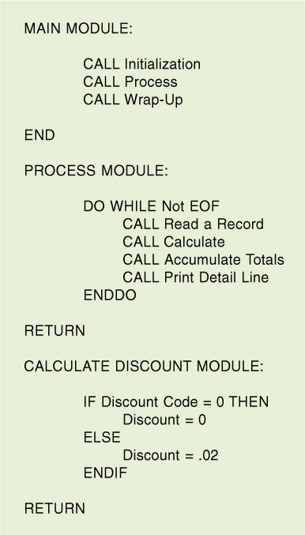
Pseudocode
Programming Languages, Chp. 12

Slide 48
Quality Review Techniques
  Desk checking
    Develop sets of valid test data
    Determine the expected results
    Step through the solution using the test data
    Compare results of steps 2 and 3
    Repeat steps 3 and 4 for each set of test data
Programming Languages, Chp. 12

Slide 49

Six Steps in Developing a Program: Step #3
syntax
Start
Input
Data
Code the Program
Process
Output
Stop
Programming Languages, Chp. 12

Slide 50
Step 3: Program Code
Writing the actual program is called coding.
This is where the programmer translates the logic of the pseudocode into actual program code.
Programs should be written on paper first.
A good program is one that is:
  Reliable
  Works under most conditions
  Catches obvious and common input errors.
Programming Languages, Chp. 12

Slide 51
Step 3 – Code Program
Translate the solution algorithm into a programming language
Enter the programming language into the computer
  Comments (remarks)
Programming Languages, Chp. 12

Slide 52
Six Steps in Developing a Program: Step #4
Test the Program
  Logic Errors
  Syntax Errors
  Bugs
debugging
Programming Languages, Chp. 12

Slide 53
Step 4 – Test Programs
Types of errors
  Syntax errors – occurs when the code violates the syntax, or grammar, of the programming language.
    Misspelling a command
    Leaving out required punctuation
    Typing command words out of order
  Logic errors a flaw in the design that generates inaccurate results.
Programming Languages, Chp. 12

Slide 54
Step 4: Test the Program
All programs must be tested for errors. This is a process known as debugging.
There are two types of errors that must be eliminated from a program before it can be used in a real-time computing environment. They are:
  Syntax Errors
  Logic Errors
Programming Languages, Chp. 12

Slide 55
Syntax and Logic Errors
Syntax errors are those which violate the rules of the language. These are frequently created when the program is input--it is a keying error. For example, instead of typing the word, “going”, the word, “gong” is typed instead.
Logic Errors are those that occur when programming instructions do not follow a logical sequence.
Programming Languages, Chp. 12

Slide 56

Debugging
There are several methods of debugging a program. They include:
  Desk checking
  Manual testing with sample data
  Testing sample data on the
  computer
  Testing by a select group of potential users.
Programming Languages, Chp. 12

Slide 57
Debugging Methods
Desk checking - checking line by line of code for syntax and/or logic errors. This is the process being used to correct the Y2K problem.
Manual Testing with Sample Data - This uses all types of data both correct and incorrect to manually test a program.
Programming Languages, Chp. 12

Slide 58
Debugging Methods
(Continued)
Testing Sample Data on the Computer - Uses all types of data (correct and incorrect) to test a program. This is done after all syntax errors are corrected.
Testing by Select Group of Potential Users - Also called beta testing. This is potential users trying a program and providing feedback.
Programming Languages, Chp. 12

Slide 59
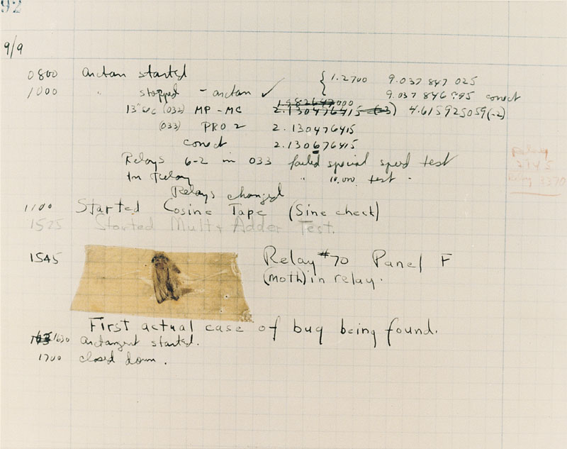
Failure of the World’s First Electro-Mechanical Computer; Thus the Term “Bugs”
  Debugging – the process of locating and correcting syntax and logic errors
Programming Languages, Chp. 12

Slide 60
Step 5 – Formulize Solution
Review program code
Review all documentation which includes:
  Hierarchy chart
  Solution algorithm in for of a program flowchart or pseudocode
  Test data
  All program code listings containing global and internal elements.
Programming Languages, Chp. 12

Slide 61
Step 5: Formalize the Solution and Conduct Program Documentation
Documentation consists of written descriptions and procedures about a program and how to use it. It is done on a continual basis throughout all the steps of the program development process.
Documentation is provided for:
  Users
  Operators
  Programmers
Programming Languages, Chp. 12

Slide 62



Six Steps in Developing a Program: Step #6
Implementation Maintenance
1+1=2
Programming Languages, Chp. 12

Slide 63
Step 6 – Maintain Programs
Correct errors
Add enhancements
  Fix errors
  Modify or expand the program
Programming Languages, Chp. 12

Slide 64
Program Maintenance
Programming maintenance activities fall into two categories: operations and changing needs.
Operations - Locating and correcting operational errors and standardizing software.
Changing Needs - Programs may need to be modified for a variety of reasons. For example new tax laws, new company policies.
Programming Languages, Chp. 12

Slide 65
Categories of Programming Languages
Types of Languages:
  Machine Language
  Assembly Language
  Higher-Level Language
Programming Languages, Chp. 12

Slide 66
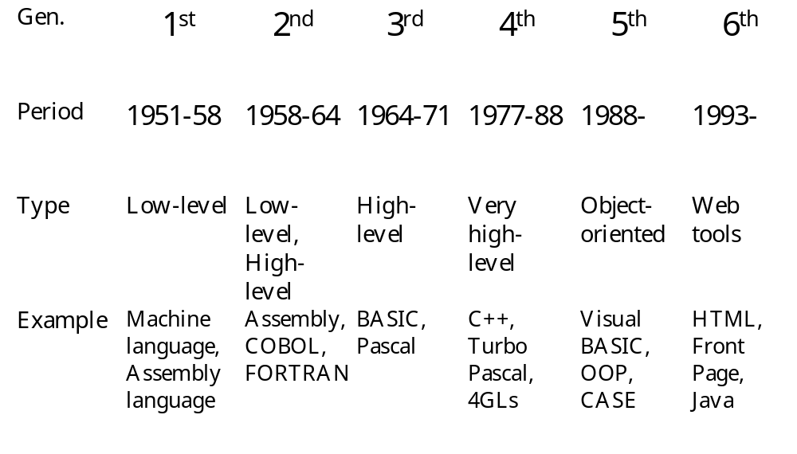
Six Generations of
Programming Languages
Programming Languages, Chp. 12

Slide 67
Programming Languages
Machine
  Binary 1s and 0s
Assembly
  Letters, Numbers and Symbols
BASIC
  Beginner’s, General Uses
COBOL
  Business, mainframe
FORTRAN
  Science, math, engineers
Pascal
  Education, PCs
C, C++
  Professionals, education
Visual Basic
  Professionals, software vendors
Programming Languages, Chp. 12

Slide 68
Higher-Level Languages:
(3rd Generation)
FORTRAN (FORmula TRANslator)
COBOL (Common Business Oriented Language)
BASIC (Beginners All-purpose Symbolic Instruction Code)
Pascal
C/C++
Java
Programming Languages, Chp. 12

Slide 69
Programming Languages and Program Development Tools
Programming language
  Set of words, symbols, and codes that enables a programmer to communicate a solution algorithm to the computer
Program development tool
  User-friendly software products designed to assist in the creation of information system solutions
Programming Languages, Chp. 12

Slide 70
Programming
(Continued)
Different programming languages are suited for different programming needs:
  Pascal is for computer science.
  COBOL is a business language.
  Fortran is an engineering language.
  BASIC is for beginners.
  OOP is object-oriented programming for the Internet.
Programming Languages, Chp. 12

Slide 71
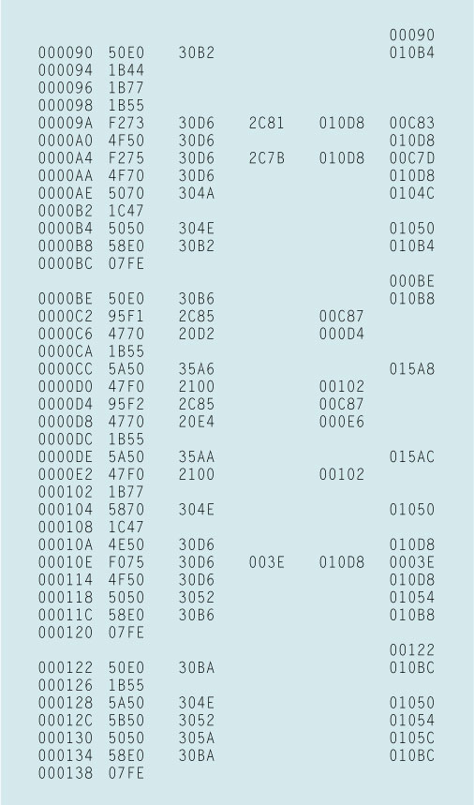
Machine Language Version (Printed in Hexadecimal)
First generation languages
Machine-Dependent: Running only on the
machine for which they were developed.
Programming Languages, Chp. 12

Slide 72
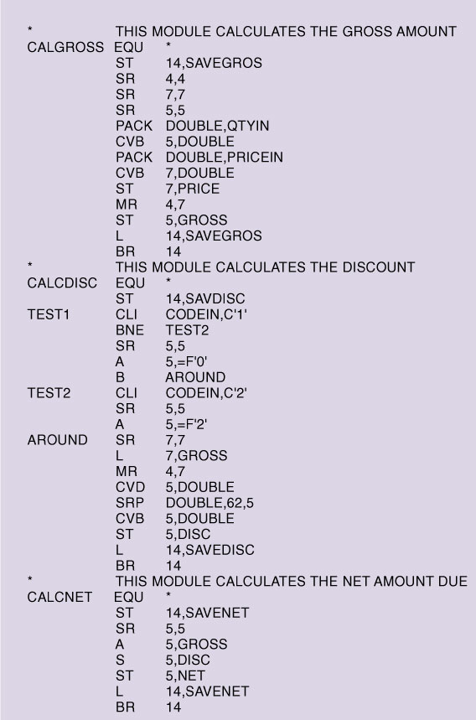
A Second Generation of Languages: Assembly Languages
Instructions are written using abbreviations and codes called mnemonics
Programming Languages, Chp. 12

Slide 73

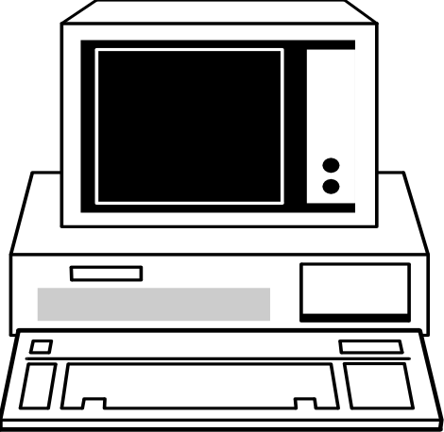
Language Translation
Source Code:
Read by People
Object Code:
Read by the
Computer
Programming Languages, Chp. 12

Slide 74

Language Translators
Assembler: Translates Assembly Language into Machine Language
Compiler: Translates entire file of source code into object code. It links to create an executable file.
Interpreter: Translates source code line by line into object code
Programming Languages, Chp. 12

Slide 75
Translators at Work
Source Code - While human-readable, still needs to have internal documentation explaining each step. Variable names must be meaningful to the potential reader.
Assembler: Assembly language is specific to computer systems, but it is written in text instructions and requires more specialized knowledge.
Programming Languages, Chp. 12

Slide 76
Program Translators
Compiler: Converts the high-level program source code into machine language object code. With a compiler, the object code can be saved and run later.
Interpreters: Converts high-level programs into machine language one statement at a time, without saving it as object code.
  This is usually used with older PCs,
  It is slower, and cannot have program errors.
Programming Languages, Chp. 12

Slide 77
Difference in a
Compiler and a Interpreter?
Compiler: If a compiler is used when a program is run, it requires two steps:
  Convert the entire program’s source code to object code
  Run the object code
Interpreter: converts and runs the program one line at a time--hence only one step required.
Programming Languages, Chp. 12

Slide 78
Advantages of a Compiler
A compiler runs much faster.
The program can be distributed to many people who don’t have compilers since a compiler is not needed after compiling occurs.
A compiler is stored as an executable file.
Programming Languages, Chp. 12

Slide 79
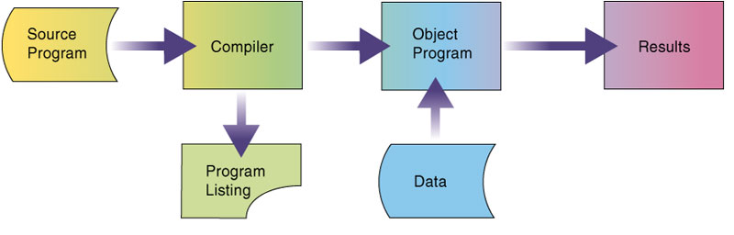
Third-Generation Languages (3GL) Compilers
Programming Languages, Chp. 12

Slide 80
But What About an Interpreter?
An interpreter breaks down each statement as it is processed.
The interpreter software is required every time the program is run.
Programming Languages, Chp. 12

Slide 81
Pros and Cons of an Interpreter
Advantage of an interpreter:
  It immediately displays feedback when it finds a syntax error.
  The programmer can correct any errors or debug the code before the interpreter evaluates the next line.
Disadvantages:
  Interpreted programs do not run as fast as compiled programs because the program must be translated to machine language each time it is executed.
Programming Languages, Chp. 12

Slide 82
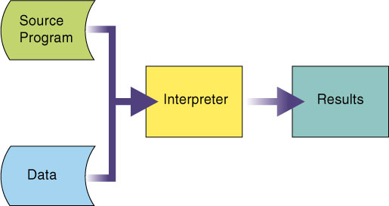
Interpreters
Programming Languages, Chp. 12

Slide 83
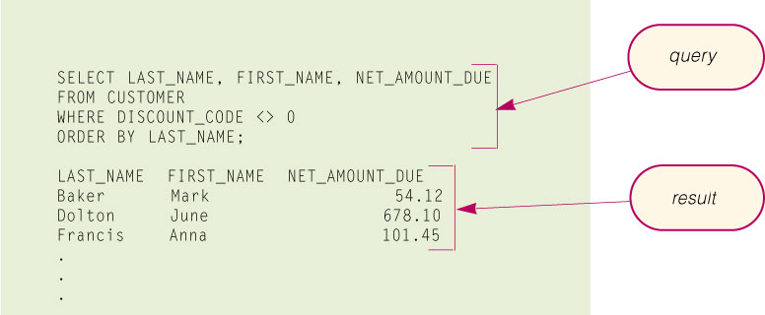
Fourth-Generation Languages (4GL)
SQL (Structured Query Language) is used
to query database tables
Programming Languages, Chp. 12

Slide 84
Pros and Cons of an Interpreter
Advantage of an interpreter:
  It immediately displays feedback when it finds a syntax error.
  The programmer can correct any errors or debug the code before the interpreter evaluates the next line.
Disadvantages:
  Interpreted programs do not run as fast as compiled programs because the program must be translated to machine language each time it is executed.
Programming Languages, Chp. 12

Slide 85
Object-Oriented Program Development
Object-Oriented Programming
  Object-oriented programming (OOP) language
  Event-driven
Programming Languages, Chp. 12

Slide 86
Web Program Development
Java, JavaScript, and Perl
  Java
  JavaScript
Programming Languages, Chp. 12

Slide 87
Languages Designed for OOP
Although several OOP languages exist -- Smalltalk, Turbo Pascal, and Hypertalk, there are two languages contending for leadership in the area of the Internet. Those two languages are:
Visual Basic
JAVA
Programming Languages, Chp. 12

Slide 88
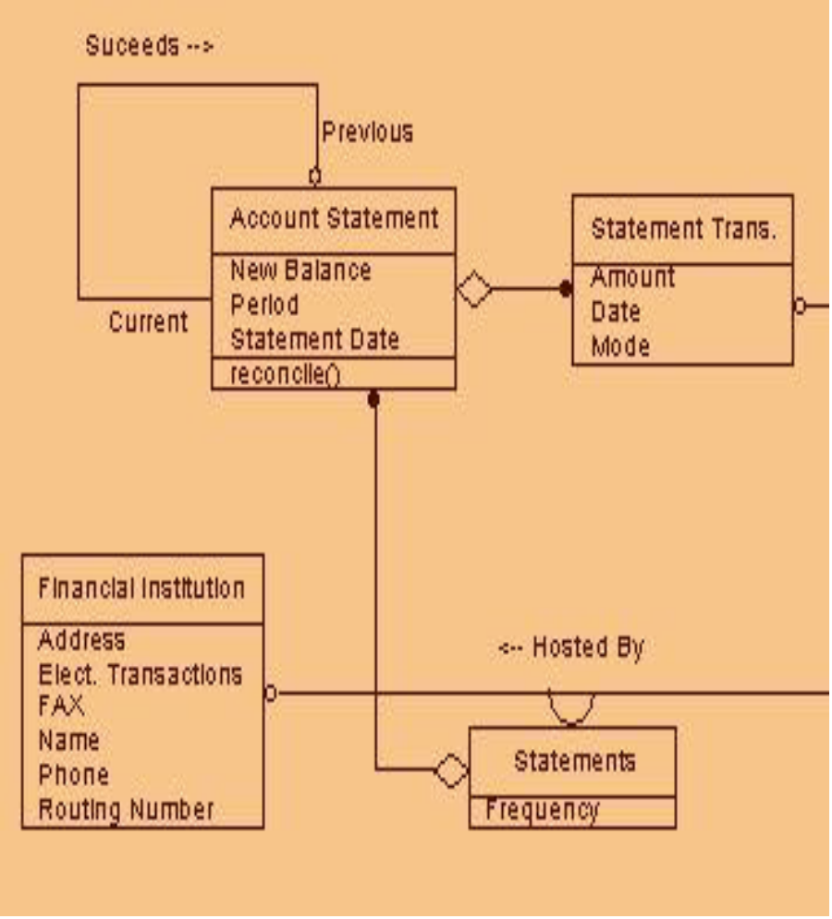
Object-Oriented Programming
OOP means better program quality and consistency
Visual Basic is OOP
Programming Languages, Chp. 12

Slide 89
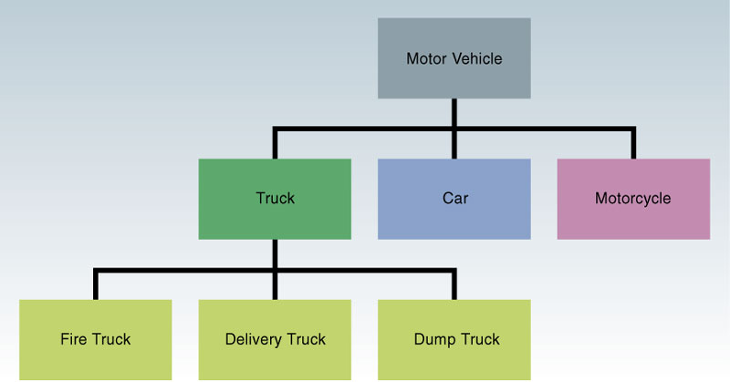
Natural Languages
Programming Languages, Chp. 12

Slide 90
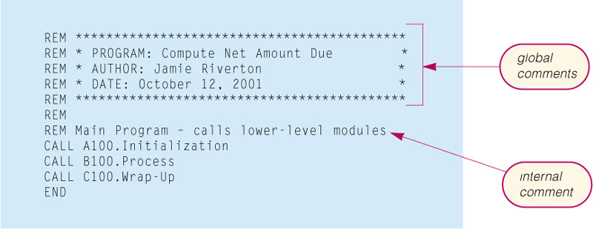
QuickBasic Program
Programming Languages, Chp. 12

Slide 91
Popular Programming Languages
BASIC
Visual Basic
  Design the graphical user interface
  Write code for program events
  Generate the application
Programming Languages, Chp. 12

Slide 92
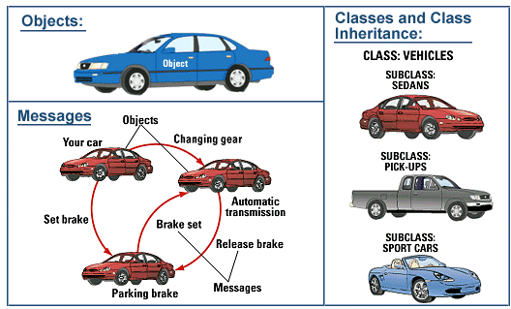
Types of Programming
Structured Programming
  practice of building programs using a set of well-defined structures.
Object-oriented Programming (OOP)
  uses reusable, modular objects to build a program.
Programming Languages, Chp. 12

Slide 93
Higher-Level Languages:
(4th Generation)
Visual Basic
Application-specific macro language
Authoring environments
Programming Languages, Chp. 12

Slide 94
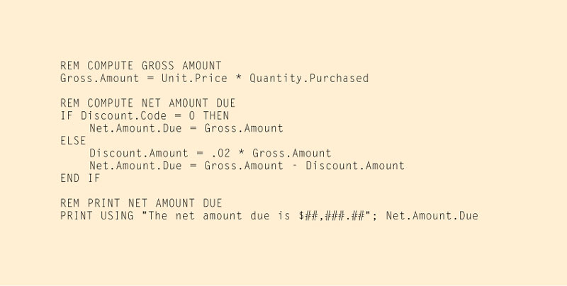
A BASIC Program
Programming Languages, Chp. 12

Slide 95
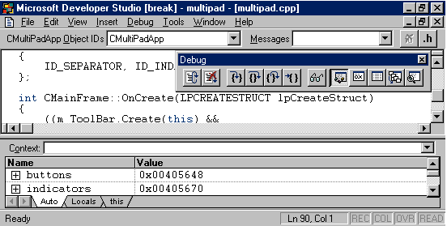
Programming is challenging
but the tools are improving
Programming Languages, Chp. 12

Slide 96
Visual Basic
With Visual Basic, a programmer can design a screen for desired appearances.
You can design menus with Visual Basic.
You can develop electronic forms.
You can create dialog boxes.
It can be used as a graphic-user interface object.
  Visual Basic Interpreter - translates each line with instruction entered into the editor.
Programming Languages, Chp. 12

Slide 97
Visual Basic
Step 1: Create the interface.
Step 2: Assign the properties to the interface.
Step 3: Write the code and assign it to the COMPUTE button.
Step 4: Test the program
Programming Languages, Chp. 12

Slide 98
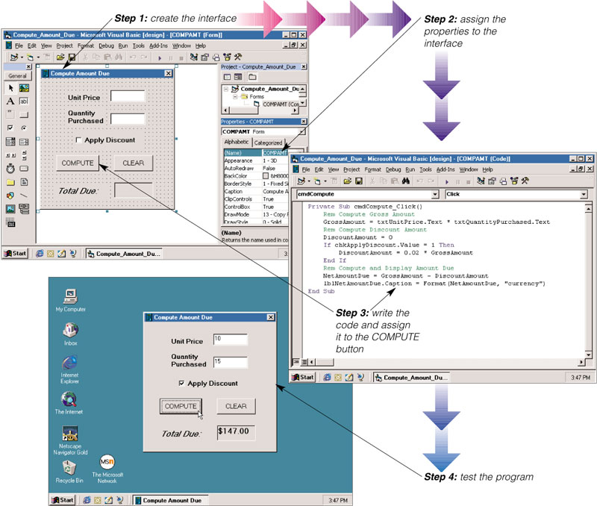
Visual Basic
Programming Languages, Chp. 12

Slide 99
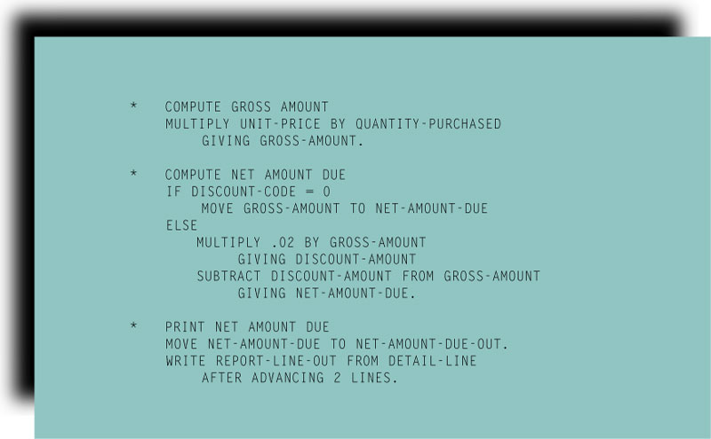
COBOL
Programming Languages, Chp. 12

Slide 100
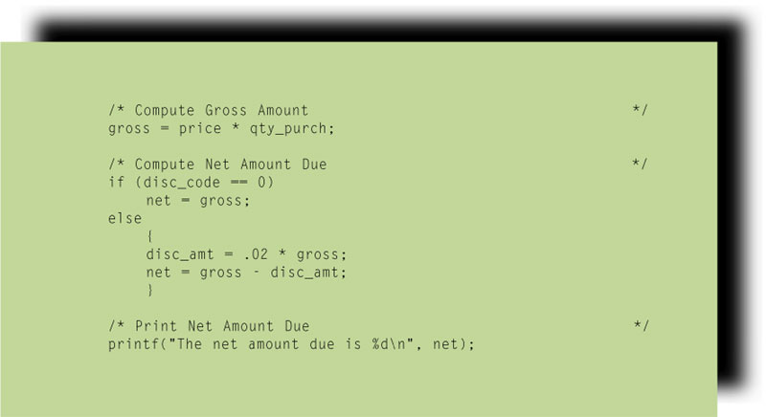
C or C++ Program Language
Programming Languages, Chp. 12

Slide 101
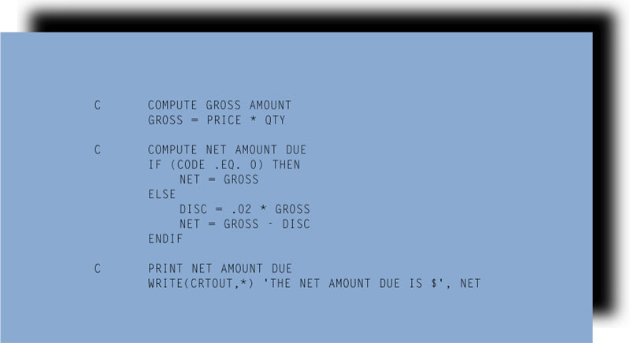
FORTRAN
Programming Languages, Chp. 12

Slide 102
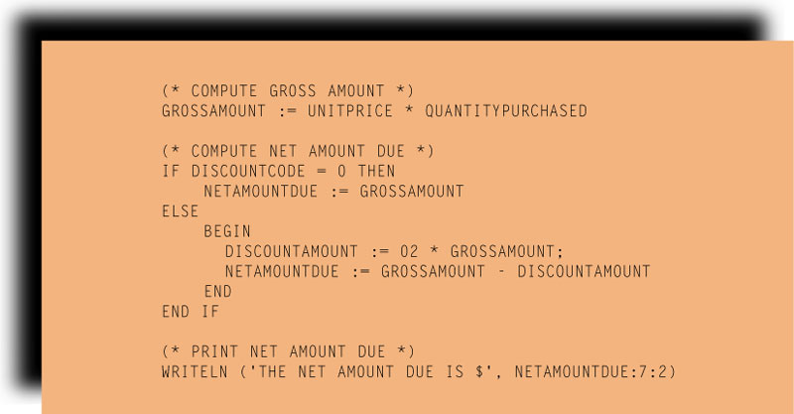
Pascal
For the purpose of teaching structured programming concepts to students.
Programming Languages, Chp. 12

Slide 103
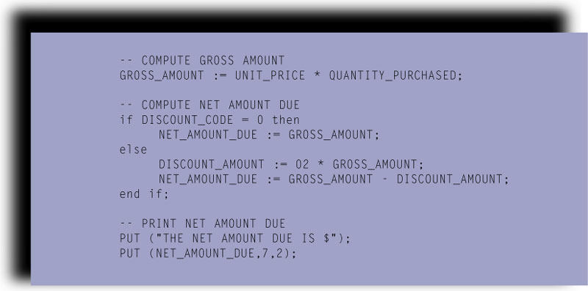
Ada
Named after Augusta Ada Lovelace Byron. Developed in 1970 by the U. S. Department of Defense. Designed to meet the needs of the embedded computer systems.
Programming Languages, Chp. 12

Slide 104
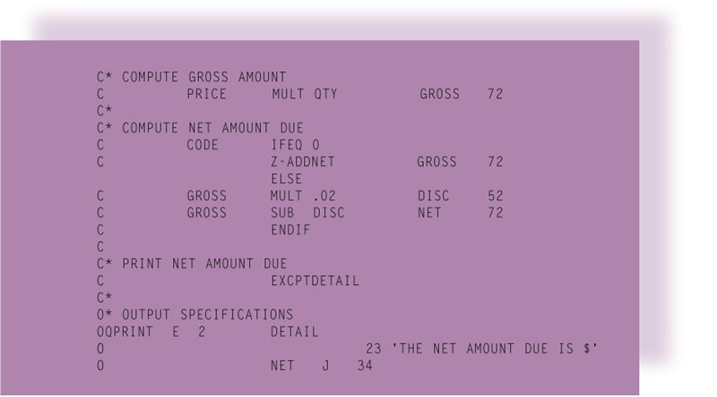
RPG (Report Program Generator)
Programming Languages, Chp. 12

Slide 105
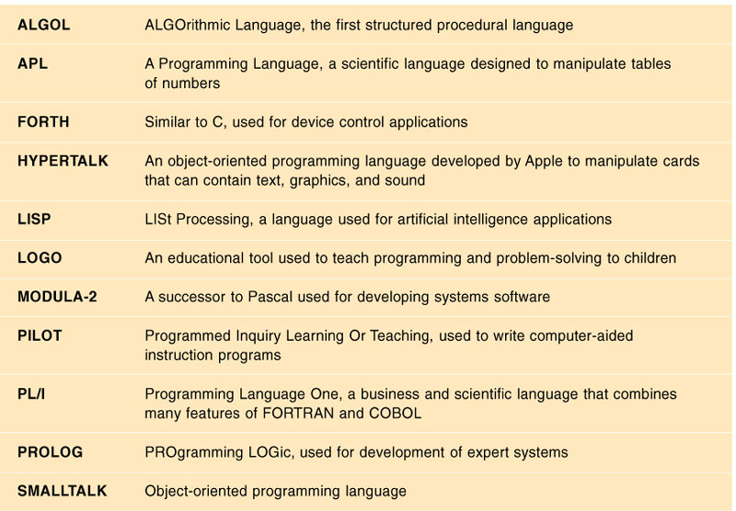
Other Programming Languages
Programming Languages, Chp. 12

Slide 106
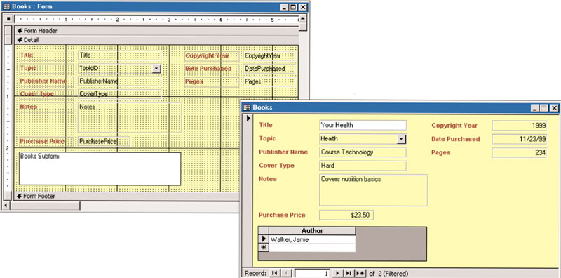
Application Generators (Program Generators)
  Allows you to build an application without writing the extensive code required by a third generation programming language.
Programming Languages, Chp. 12

Slide 107
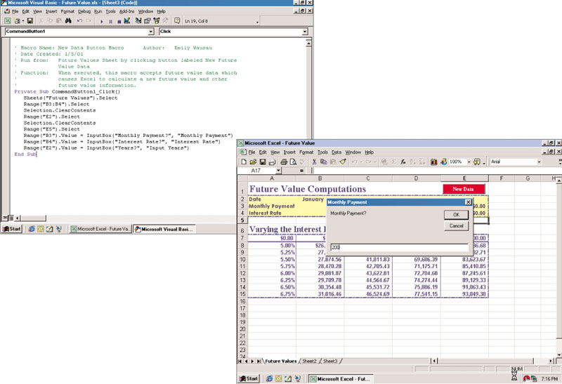
Macros
  Recording macros
  Writing macros
  Running macros
Programming Languages, Chp. 12

Slide 108
RAD Tools
A common approach with RAD Tools is prototyping.
  A prototype is a working model of the proposed system. With a prototype, it only requires a minimum amount of work to convert the prototype into an implemented solution; thus, the programmers can develop the application rapidly.
Programming Languages, Chp. 12

Slide 109
HTML
HTML
  Hypertext markup language (HTML)
  Tags (markups)
Programming Languages, Chp. 12

Slide 110
HyperText Markup Language
HTML
HTML CODE
<html>
<head>
<meta name="keywords" content="country living, quality of life">
<title>Sticks</title>
</head>
<frameset framespacing="0" frameborder="0" cols="155,*" rows="100%">
<frame src="menu.html" name="menu" scrolling="AUTO">
<frame src="sticks.html" name="main" scrolling="AUTO">
</frameset>
</html>
A Programming Language for the Web
Often Incorporated into other Applications:
  WP, Web Browser
Also a Standalone Tool or Program:
  Front Page, HoTMetaL
Programming Languages, Chp. 12

Slide 111
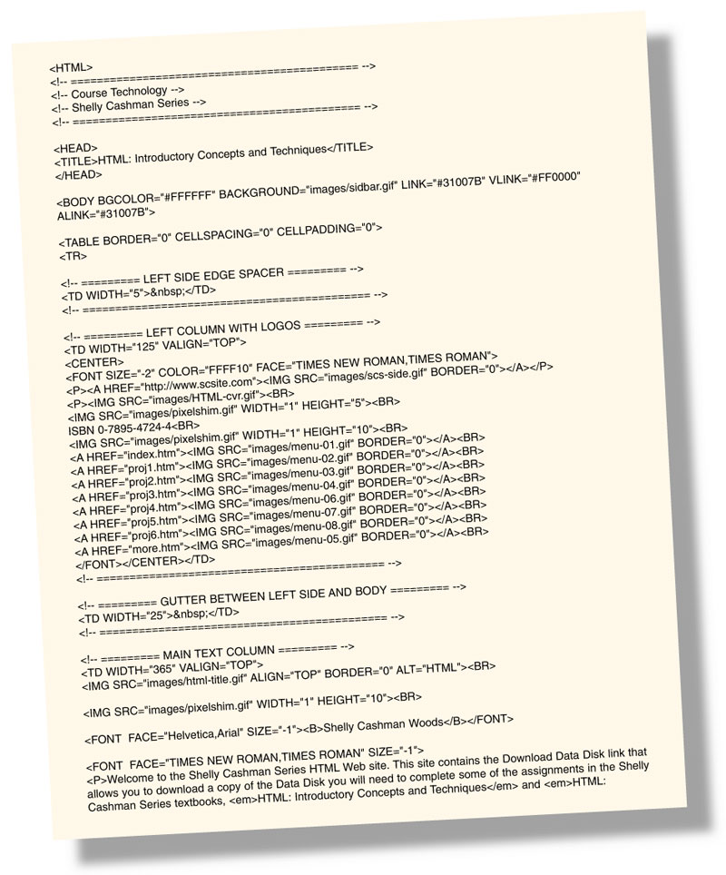
HTML (Hypertext Markup Language)
Programming Languages, Chp. 12

Slide 112
Java
JAVA PROGRAM CODE
* This method is called by the thread that was created in
* the start method. It does the main animation.
*/
public void run() {
// Remember the starting time
setBackground(Color.white);
long tm = System.currentTimeMillis();
while (Thread.currentThread() == animator) {
// Display the next frame of animation.
repaint();
// Delay depending on how far we are behind.
try {
tm += delay;
Popular Language for Web Development
Developed at Sun Microsystems
Based on C++
Often used for Web Page Animations
Programming Languages, Chp. 12

Slide 113
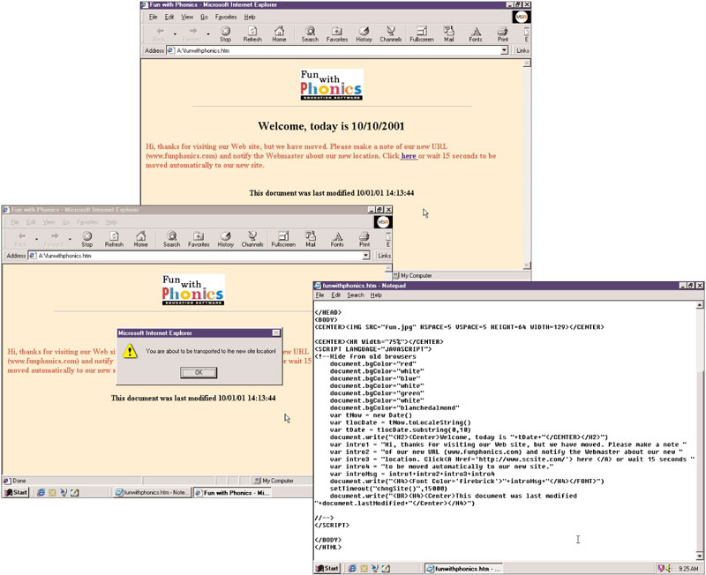
JavaScript – A Popular Scripting Language
Programming Languages, Chp. 12

Slide 114
Dynamic HTML (DHMTL)
Dynamic HTML (DHMTL)
  Allows more graphical interest and interactivity in Web pages
  Style sheets
    Cascading style sheets (CSS)
Programming Languages, Chp. 12

Slide 115
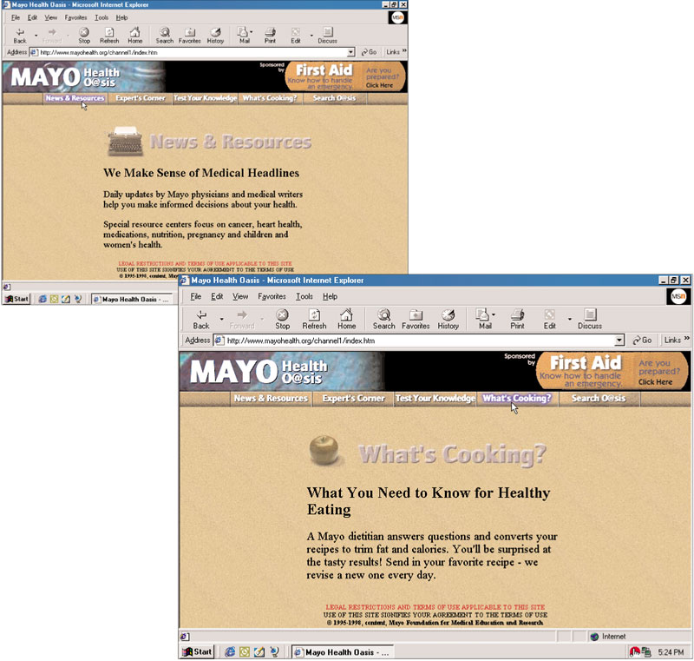
Dynamic HTML (DHMTL)
Programming Languages, Chp. 12

Slide 116
XML
  eXtensible Markup Language
  More versatile than HTML
  Allows Web page developers to create customized tags, as well as using predefined tags.
  With XML, you can define a link that points to multiple Web sites instead of a single site.
  Style sheets
    Extensible Stylesheet Language (XSL)
  May replace HTML
Programming Languages, Chp. 12

